Slide 1
Car-Nerd
Phase 3
Dynamic Developers

Slide 2
Introduction
In this phase, we explored some diagrams:
The ERD, which will show the relationships of data in our application.
A DFD, which will show the way data flows through the program.
In addition to that, we examined:
Use Cases - which will detail how a user will interact with the program to achieve expected outcome which is being able to organize and maintain vehicle information.
Quality Management - to ensure that we provide users with a quality product.

Slide 3
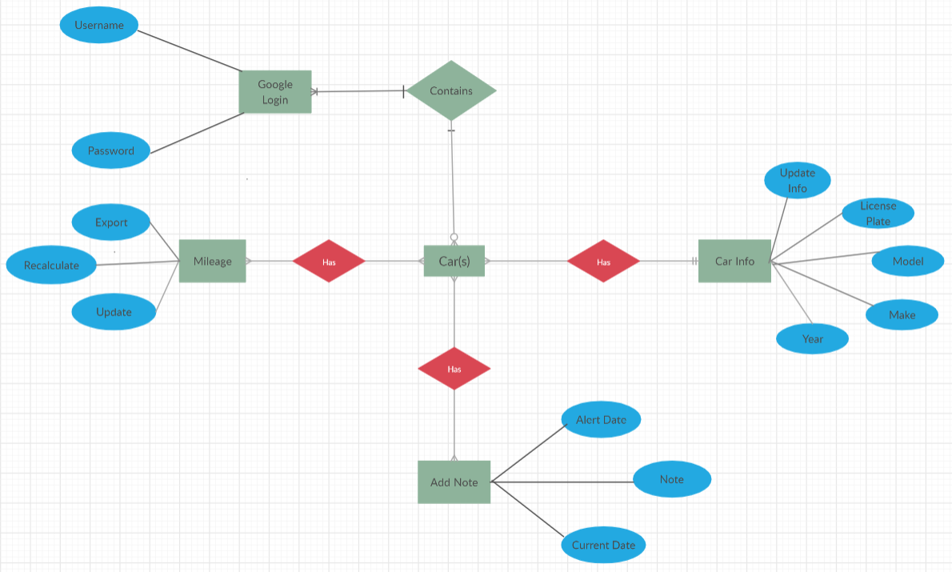
ERD Diagram

Slide 4
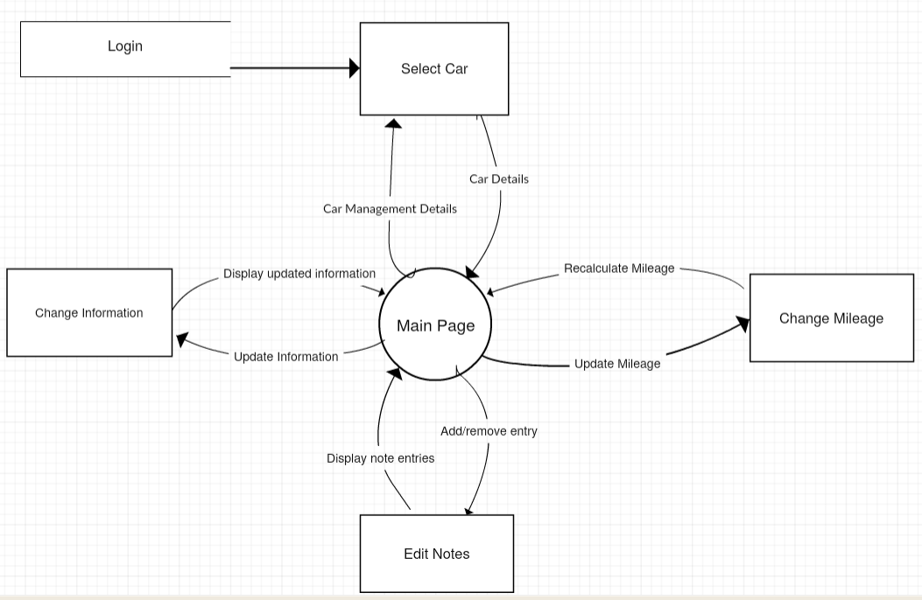
Data Flow Diagram - Level 0
Notes:
As you can see that

Slide 5
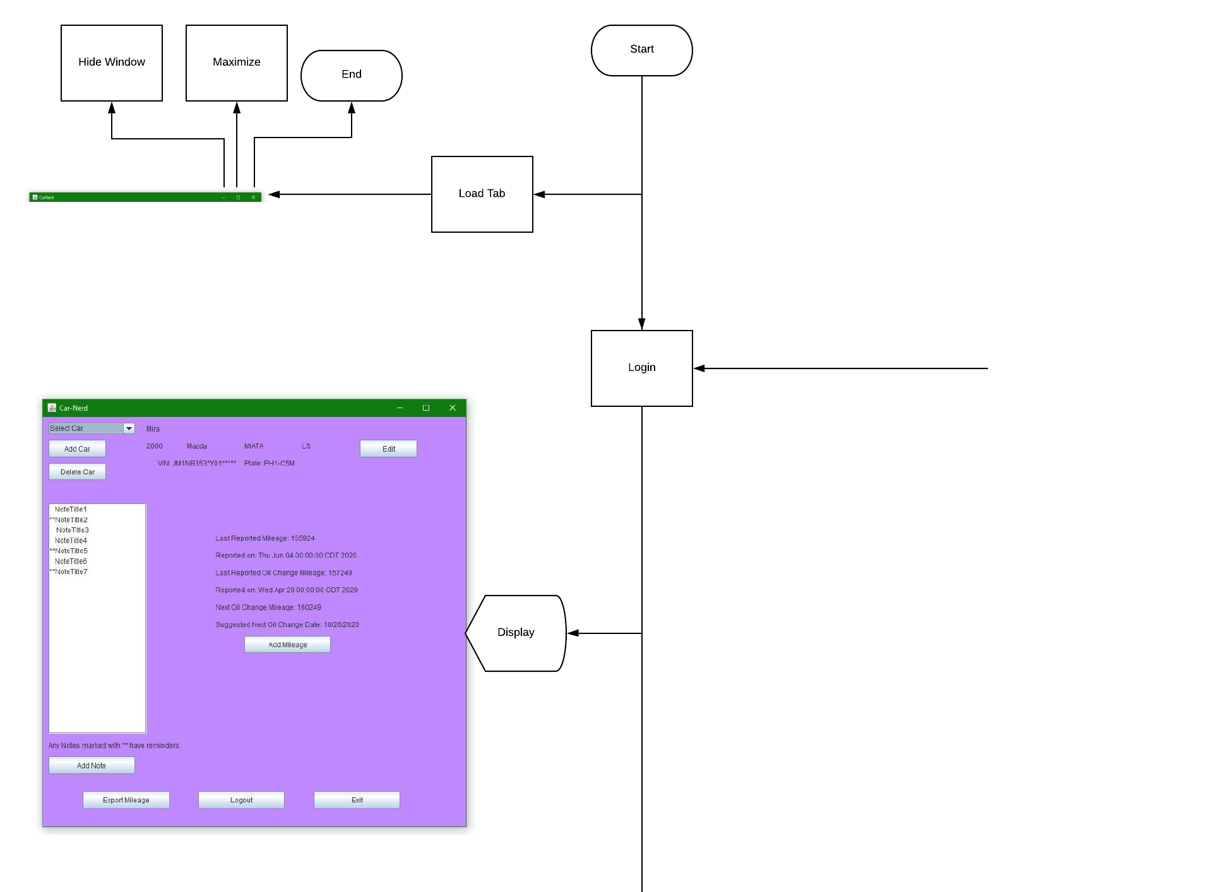
System Architecture
From logout
To Profile

Slide 6
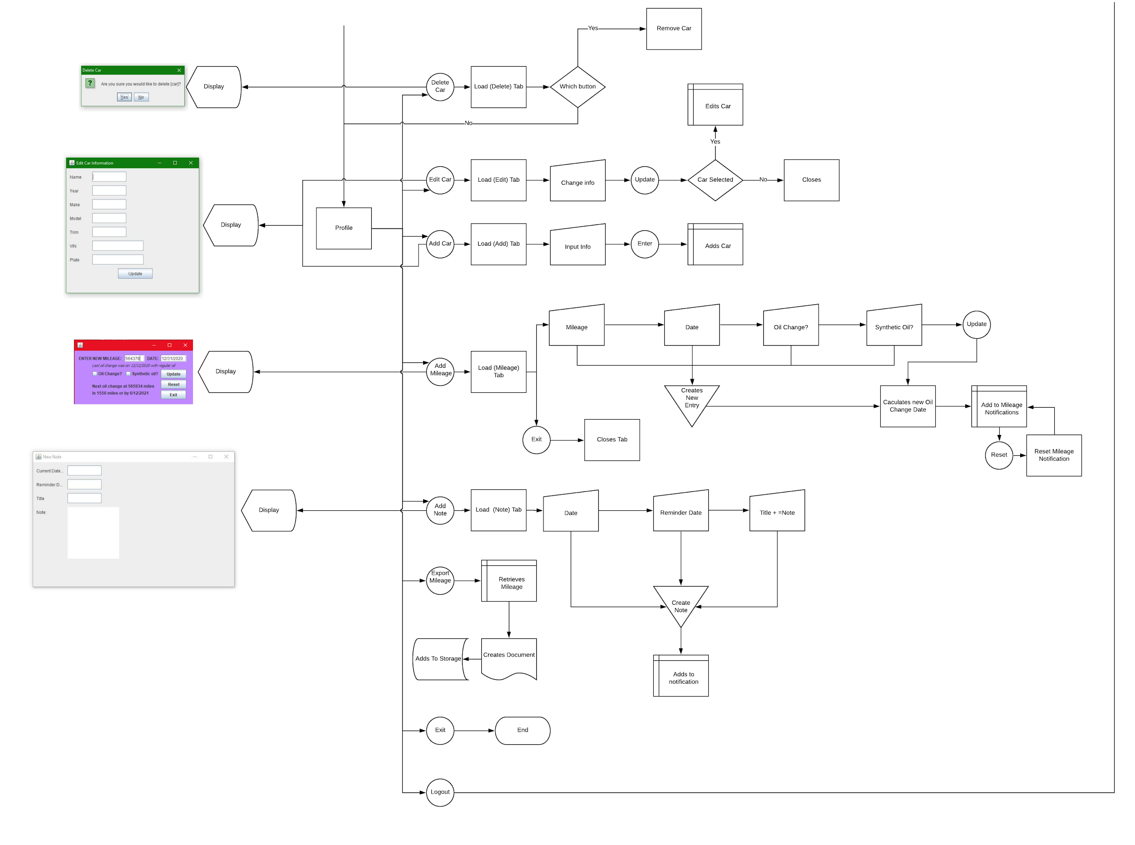
From login
To Login

Slide 7
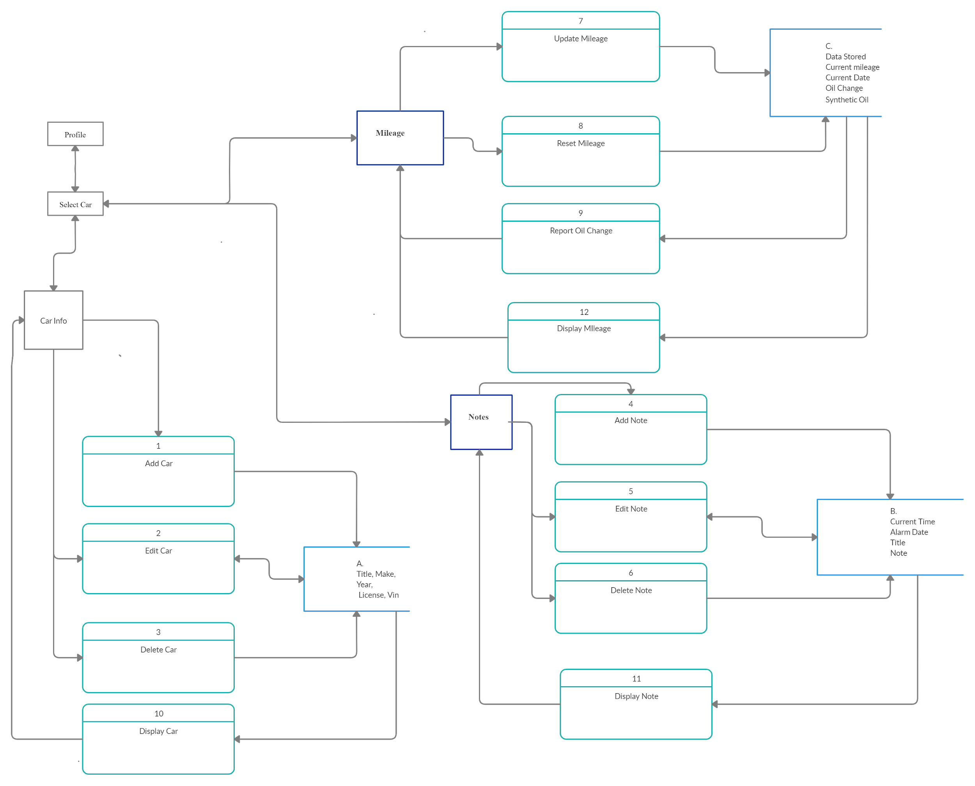
Data Flow Diagram - Level 1

Slide 8
Use-Case: Pre-conditions of Car-Nerd
Legitimate copy of Car-Nerd software
Internet Connection
At least one car to maintain
Notes:
(Alyssa) I will be walking through a basic Use-Case for Car-Nerd.
Before a user can use Car-Nerd, certain conditions must be met by the user. The user must purchase and install a legitimate copy of the software, have an active internet connection, and have at least one car that they would like to log information for.

Slide 9
Use-Case: Standard User Flow
User opens the Car-Nerd program.
User uses personal credentials to log in
User selects the Add Car button.
User adds a new car.
User selects car from dropdown list.
User reviews car information and alerts
User selects Add Notes button
User adds notes
User selects the Add Mileage button
User adds Mileage with the latest mileage
User Saves changes
User exports all existing mileage to .csv
User logs out of profile.
User exits program.
Notes:
(Alyssa) In a standard or basic case, a user would follow a certain flow. First, the user would open the program and provide proper credentials to log in. The user then would click the add car button and proceed to enter in their car’s information, assuming this is their first time opening the app. If they were returning users, they could select their already entered car. After selecting a car, the user would review their car’s info and be alerted to any reminders set previously that are due to be shown. At this point, the user’s path forks into three points and the user can choose any, all, or none of the next actions. The user can click add mileage to add a current mileage and date, checking the oil change check box if applicable. The user also can click the add note button to add a maintenance note, or any other note that the user may need to use later. The user can also export all mileage to a .csv for further analytics by pressing the export button. After the user is finished updating and adding, then they would click save changes, or logout without save, and exit the program.

Slide 10
Use-Case: Alternative Flows
User opens Car-Nerd
User uses personal credentials to log in
User selects Add Car button
User fails to properly provide proper information in adding a new car
User is unable to select a car since a car could not properly be added assuming no other cars exist
User opens Car-Nerd
User uses personal credentials to log in
User selects Add Car button
User adds a new car
User selects car from dropdown list
User reviews car information and alerts
User selects Add Note button.
User fails to accurately provide all required information to add new note
An error message is produced and no note information was saved
User opens Car-Nerd
User uses personal credentials to log in
User selects Add Car button
User adds a new car
User selects car from dropdown list
User reviews car information and alerts
User selects Add Mileage button
User fails to accurately provide all required information to add new mileage
An error message is produced and no mileage information was saved
User opens Car-Nerd
User fails to produce proper credentials
User is unable to access any car details, add mileage, or add notes
Notes:
(Alyssa) Alternative flows exist when a user enters a bad value, or doesn’t follow the proper flow of the program. If the user opens the program and fails to provide proper credentials, the user is unable to proceed any further in the app, and the flow stops here. Another example would be if the user puts in proper credentials, clicks add car button and fails to provide proper information based on the fields. Then, the user flow would stop here, and they would not be able to review their car’s information.

Slide 11
Quality Management
Quality Management Approach -
Ensure that quality is part of every process and tasks that will be performed
Focus on project deliverables and criteria being used for development
Quality Group will comprise of the Dynamic Developers’ development team and project manager.
Metrics and standards include:
Resources
Performance procedures
Application procedures

Slide 12
Quality Controls
Product | Physical/Performance Standards | Quality Assessment Activities | Assessment Intervals
Data Handling | User inputs saved without data loss. | Debugging and user testing. | Per development release, customer feedback, or update.
User Navigation | Users able to intuitively navigate the UI | User testing and surveying. | Per development release, update, customer feedback, or UI change.
Useful and Relevant Features | Features are useful and relevant and work as expected | User testing and surveying. | Per development release, customer feedback, or feature update.
Streamlined Coding and Developing | Code is updatable and understandable by current and future developers. | Meetings and reviews of code with development team. | Per development release or updates.

Slide 13
Quality Checklist:
The Quality Group used the Quality Checklist as a guideline to review the measures that are currently in place and to outline what measures still need to be addressed to improve the Quality Management Plan. Some highlights from the Checklist include:
We have assigned a Quality Management Manager (the Project Manager)
A repository has been established and all the Quality Group is aware of how to access that documentation.
Quality metrics have been established and agreed upon by the Quality Group. They include:
System audits to ensure that users are experiencing expected results
10 or more successful trial runs
Customer satisfaction
Other quality standard items that are a work in progress:
Since quality improvements have yet to be reported, do not have a change control process to accommodate project changes currently.
At this time, we do not have an appropriate number of resources assigned for quality assurance and control
More staff would be needed so that team members can focus on their primary responsibility (development, managing the project, etc)
Unsure if metrics support quality standards are acceptable to the customer
Have not reached testing phase, but will review and update standards as needed once completed.

Slide 14
Questions
?

